Slide 1
Integrated Disease Surveillance (IDS - Mozambique) Data analysis plan
data analysis plan for the surveillance systems and for their integration
Presented by: Edna Viegas, MD PhD (on behalf of the IDS country team)
Maputo, 9 January 2025

Slide 2
Content of the presentation
IDS objectives
Conceptual framework for integrated surveillance on information system and data analysis level
Summarized integrated data analysis plan
Main IDS products and outputs
Next steps

Slide 3
IDS Moz specific objectives
To determine the disease burden in the surveillance area
To identify early circulation of pathogens of interest
To monitor the genetic evolution of the pathogens of interest
To monitor antimicrobial resistance for the pathogens of interest
To determine population immunity to the diseases of interest
To determine post-vaccination immunity in children with confirmed disease

Slide 4








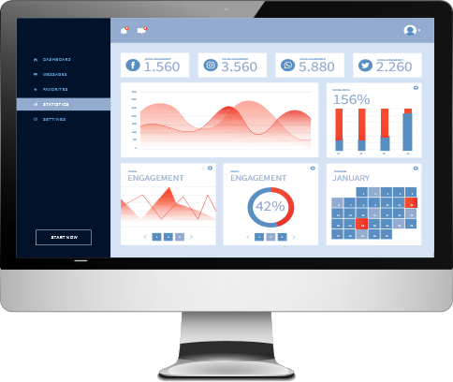

Flow vision and integration of data and systems
Level 1
Samples
Level 2
Laboratory Testing
Level 3
Community
Surveillance
Serology
Data warehouse
INFLUENZA
Catchement area
SARS-COV-2
TYPHOID
PCR
CHOLERA
Hospital Based Surveillance
POLIO
Unified Form
Level 4
Genomic
Surveillance
One System
(PCR and Sequencing)
Integrated Data Analysis
(predefined indicators)
Environmental
Surveillance
Other
Level 5
Data
Products

Slide 5






Flow vision and integration of data and systems
DATA COLLECTION
PostgreSQL
DATA ANALYSIS
PRODUCTS
DATA TO ACTION
Clinical and epidemiological data
Public access
Dashboard
INS Website
Retro information to the community
Descriptive analysis
Laboratory data
Spatial analysis
Data triangulation
Epidemiological bulletin
Decision makers
Data modeling
Summary information sheets
SIS-MA (DHIS-2)
Epidemiological reports
Public health programs (E.g. VPD)
Operational emergency centers (MOH)
Health sector early warning system
Multisectoral initiatives
Brochures and infographics
Scientific papers

Slide 6
IDS integrated data analysis plan
Level 3: unplanned integrated analysis (incl. special analysis and modelling)
Based on epidemiological trends
Based on new research questions
Level 2: routine/ planned integrated analysis
Spatial analysis
Modelling
Level 1: descriptive analysis
Per surveillance domain
Per pathogen

Slide 7
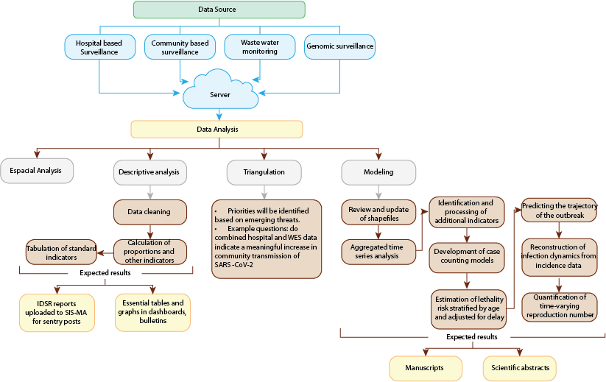

Slide 8


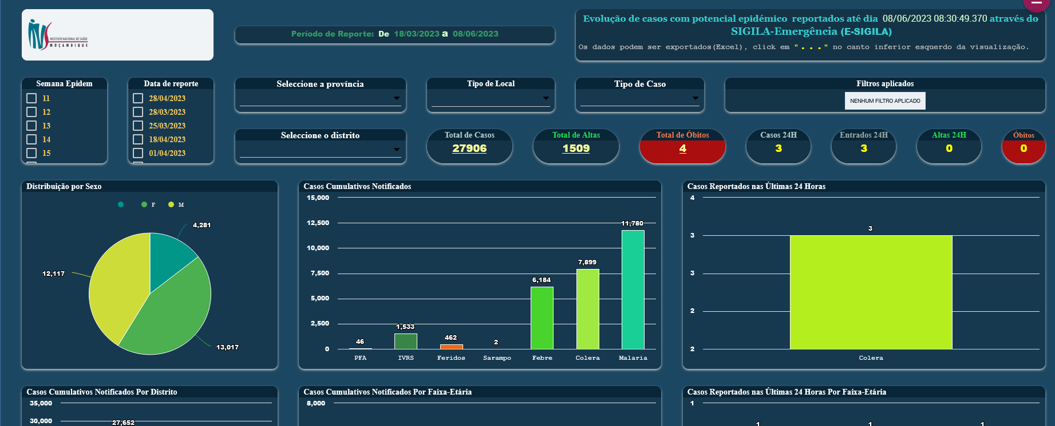



IDS information systems
Surveillance
Restricted epi dashboard
INS Public Website
Community Surveillance
Hospital Based Surveillance
Environmental Surveillance
ODK
Data management Dashboard
Data Analysis portal
DISA and others
Laboratory
Serology
Microbiology
PCR
Genomic Surveillance
(PCR and Sequencing)

Slide 9
IDS information systems
Surveillance
Community Surveillance
Hospital Based Surveillance
Environmental Surveillance
ODK
Data management Dashboard
Data Analysis portal
Restricted epi dashboard
INS Public Website
DISA and others
Laboratory
Serology
Microbiology
PCR
Genomic Surveillance
(PCR and Sequencing)

Slide 10
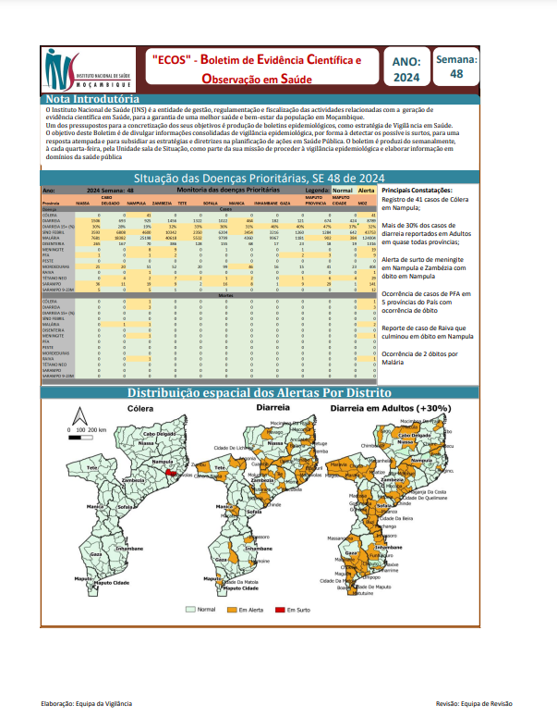
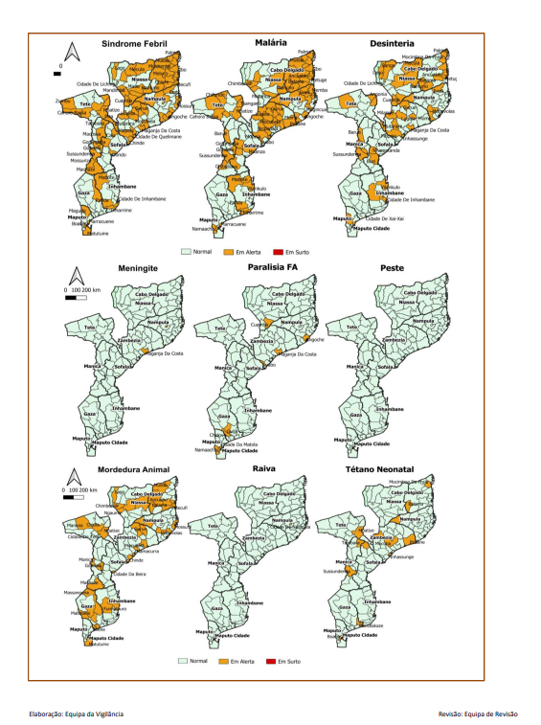
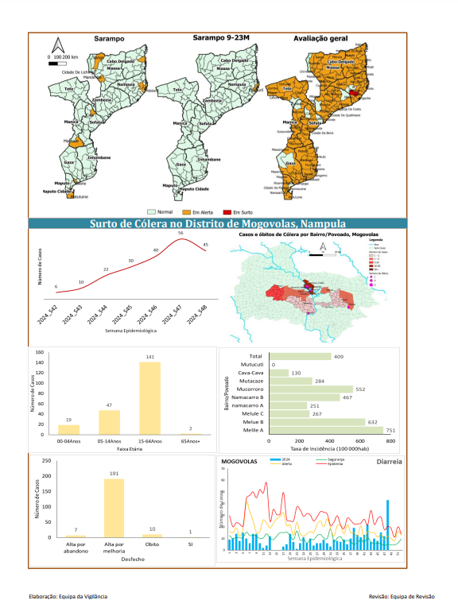
IDS epidemiological bulletin

Slide 11
Appendices
IDS detailed table of indicators
Terms of References for the Integrated surveillance dashboard
Terms of References for the Integrated surveillance epidemiological bulletins
Terms of References for the data team
Data to action strategy
Detailed integrated analysis plan (preliminary draft)

Slide 12
Next steps
Detailed data analysis plan (tabulation plan)
Detailed timeline of activities
Data triangulation training with IsGLOBAL
Data modelling training with IHME

Slide 13
Implementation & Evaluation of the Implementation Process of the Integrated Disease Surveillance Pilot in Mozambique, 2024-2025

Slide 14
Aims
Describe the pilot implementation;
Evaluate the pilot implementation process
Describe the fidelity of the implementation
Describe the determinants of successful intervention implementation.

Slide 15
Implementation Evaluation Fidelity Study
Implementation Description
Description of fidelity
Proctor 's recommendation (Proctor 2013)
1) Name, 2) define, 3) specify i
Review study documents
Write the draft of the intervention
Validate with the team (focus group discussion)
Write the final version of the intervention
Intervention described vs implemented (Carrol 2009)
1) Content, 2) frequency, 3) duration
Quarterly
Use of primary and secondary data
Quantitative analysis to report fidelity percentage
Qualitative analysis to understand the reasons for non-compliance

Slide 16
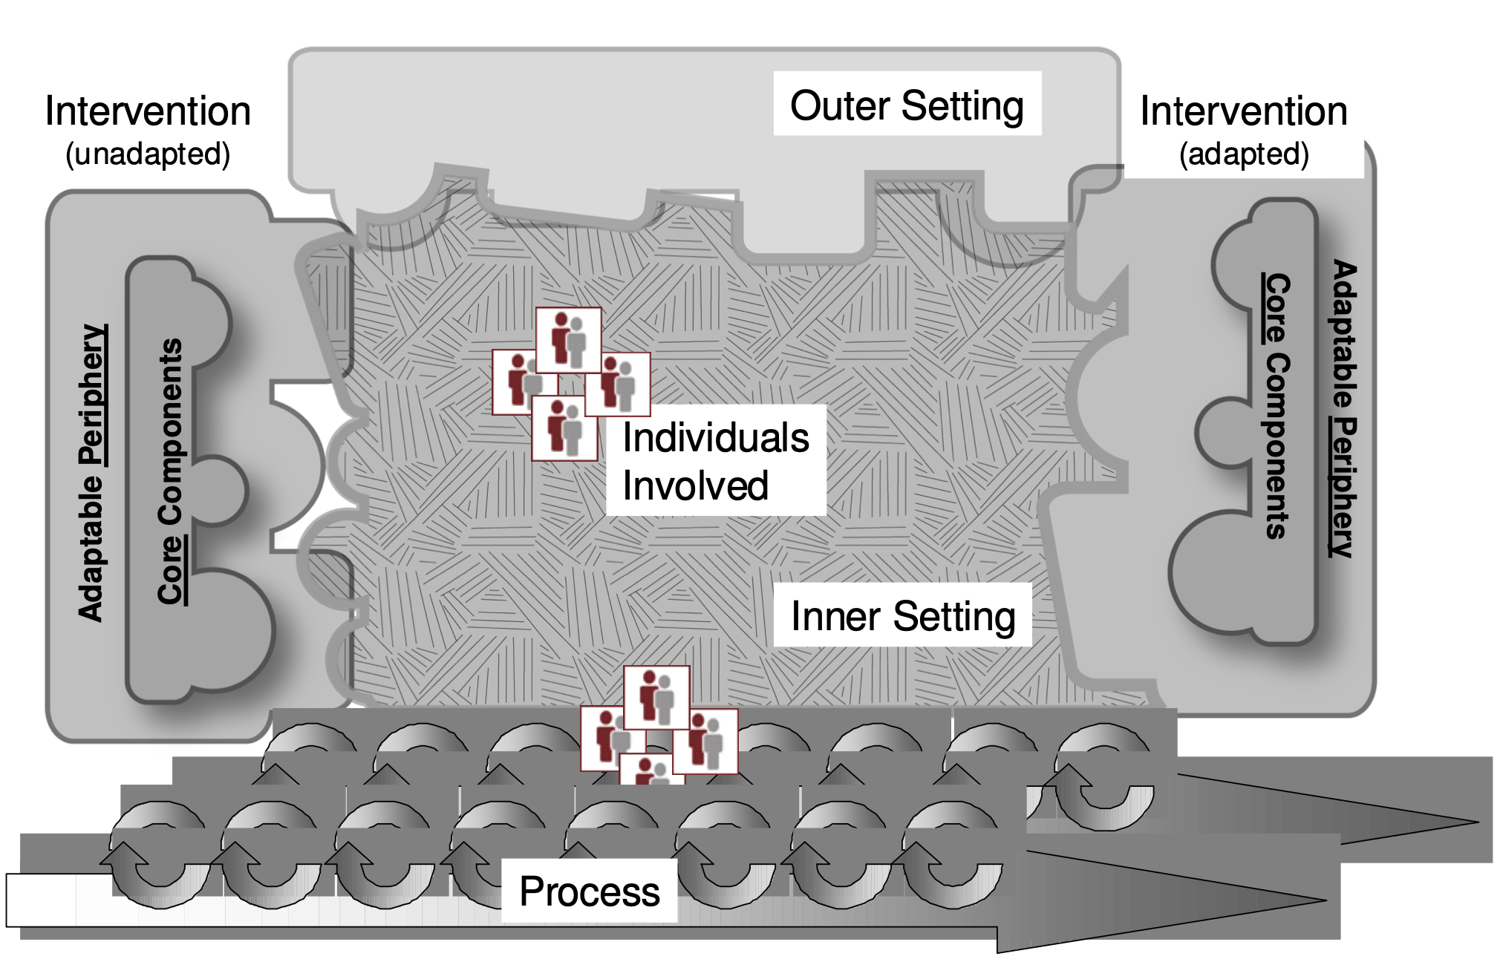
Implementation Assessment Study of the determinants of successful implementation
Type of study
Qualitative
In-depth individual interviews
Period
6 months after the start and at the end of the pilot
Participants
Managers and implementers
9 to 17 key informants
Data collection and analysis
Guided by CFIR
Thematic analysis ( deductive-inductive )
The Consolidated Framework for Implementation Research (CFIR)

